Slide 1

B.N COLLEGE OF PHARMACY LUCKNOW
PRESENTATION ON PRACTICE SCHOOL (BP706PS)
Molecular docking
Presented by –
Sarfraj Ansari
B pharm 4th
Roll no -2109190500051
Presented to - Mr. Anupam Verma
BNCP, LUCKNOW

Slide 2
Contents
Introduction
Objective
Type of molecular docking
Docking software
Docking steps
Application
Conclusion
reference

Slide 3
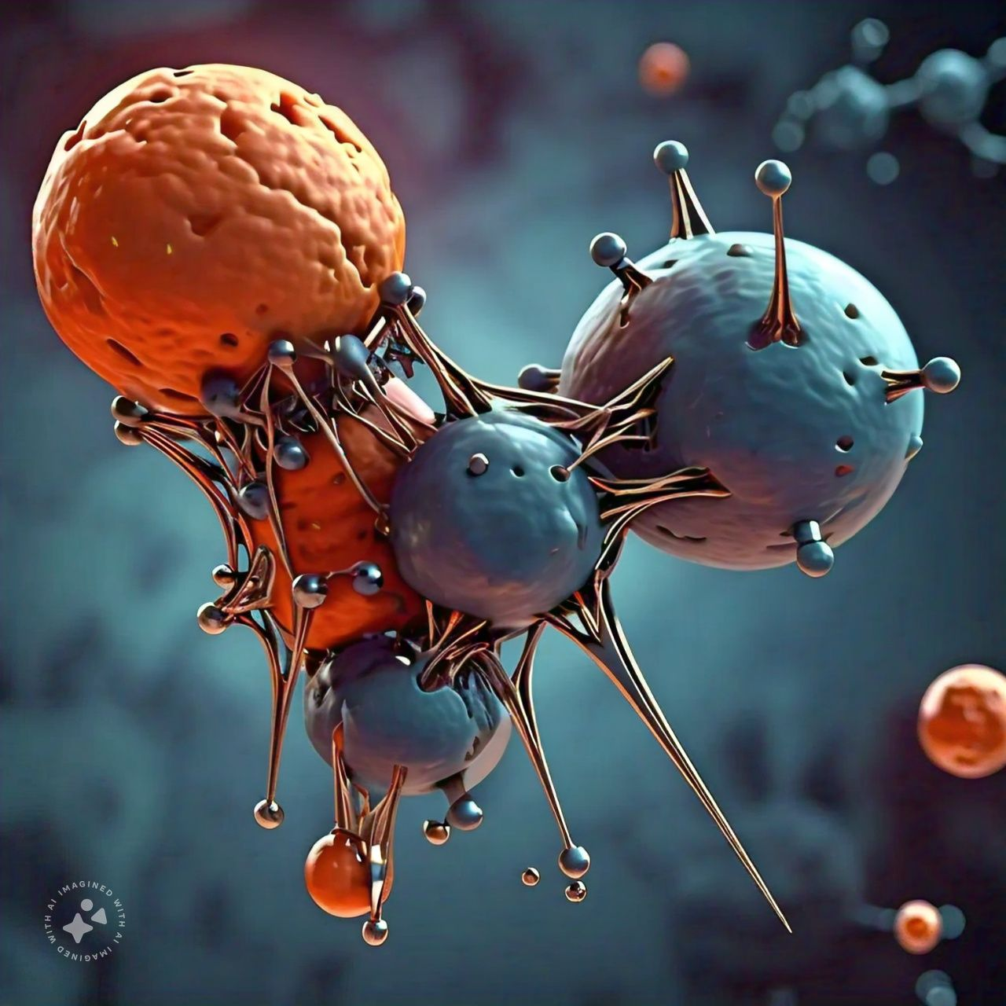
Introduction
Molecular docking is a computational process that predicts the preferred orientation and binding mode of a ligand (small molecule) to a receptor (protein).

Slide 4
OBjective
Predict binding affinity and specificity.
Identify potential lead compounds.
Optimize ligand design.
Understand protein-ligand interactions.
Guide experimental design.

Slide 5
Type of molecular docking
Protein-ligand docking.
Protein-protein docking.
Protein-DNA/RNA docking.
Virtual screening.

Slide 6
Docking software
AutoDock
Glide
Gold
FlexX
Dock
PyMOL
Molecular Operating Environment (MOE)

Slide 7
Docking steps
Protein preparation
Ligand preparation
Docking simulation
Scoring and ranking
Visualization and analysis

Slide 8
Applications
Drug discovery and development
Structural biology
Protein engineering
Computational chemistry
Molecular dynamics simulations

Slide 9
Conclusion
Molecular docking serves as a powerful computational tool used extensively in drug discovery, structural biology, and computational chemistry. By predicting the binding orientation and interaction of small molecules with target proteins, it helps researchers design and optimize ligands, understand biological mechanisms, and guide experimental processes. Despite challenges such as protein and ligand flexibility, accuracy limitations, and resource demands, best practices like using multiple algorithms and validating results with experimental data can enhance the reliability of docking studies. Molecular docking continues to evolve as a critical method for advancing therapeutic development and other scientific fields.

Slide 10
Reference
AutoDock: Morris, G. M., et al. "AutoDock4 and AutoDockTools4: Automated Docking with Selective Receptor Flexibility." Journal of Computational Chemistry. Available at: AutoDock.
MOE: Molecular Operating Environment (MOE). Available at: MOE
https://www.nature.com/articles/s41598-023-40160-2#:~:text=Molecular%20docking%20is%20a%20computational,formidable%20tool%20for%20drug%20development.
https://en.wikipedia.org/wiki/Docking_(molecular).

Slide 11


